Slide 1
Visualizing Uncertainty
Rehaf AlJammaz
Elisabeth Oliver
Carinne Knight
Abdul Jawad

Slide 2
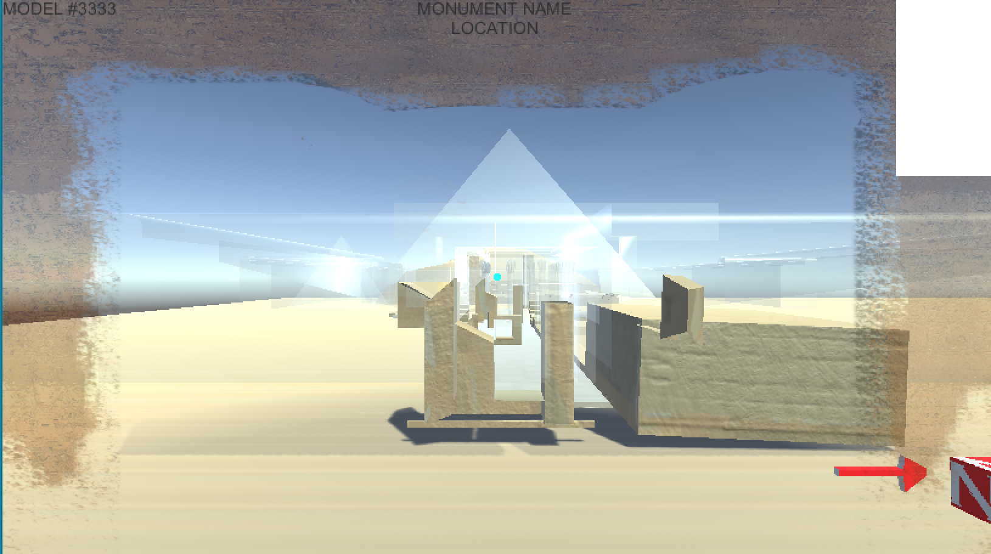
Overview

Slide 3
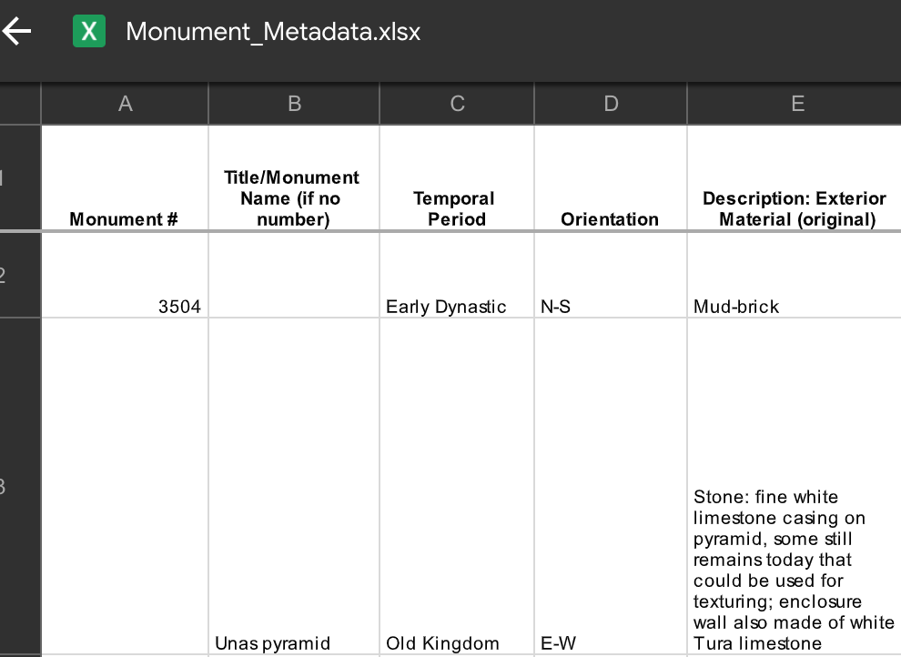
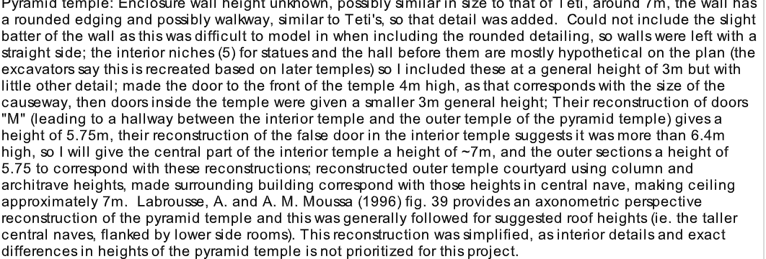
Data

Slide 4
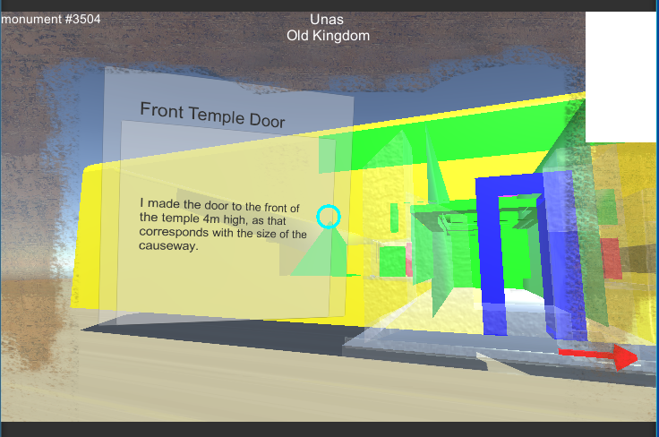
Pop up and display data

Slide 5
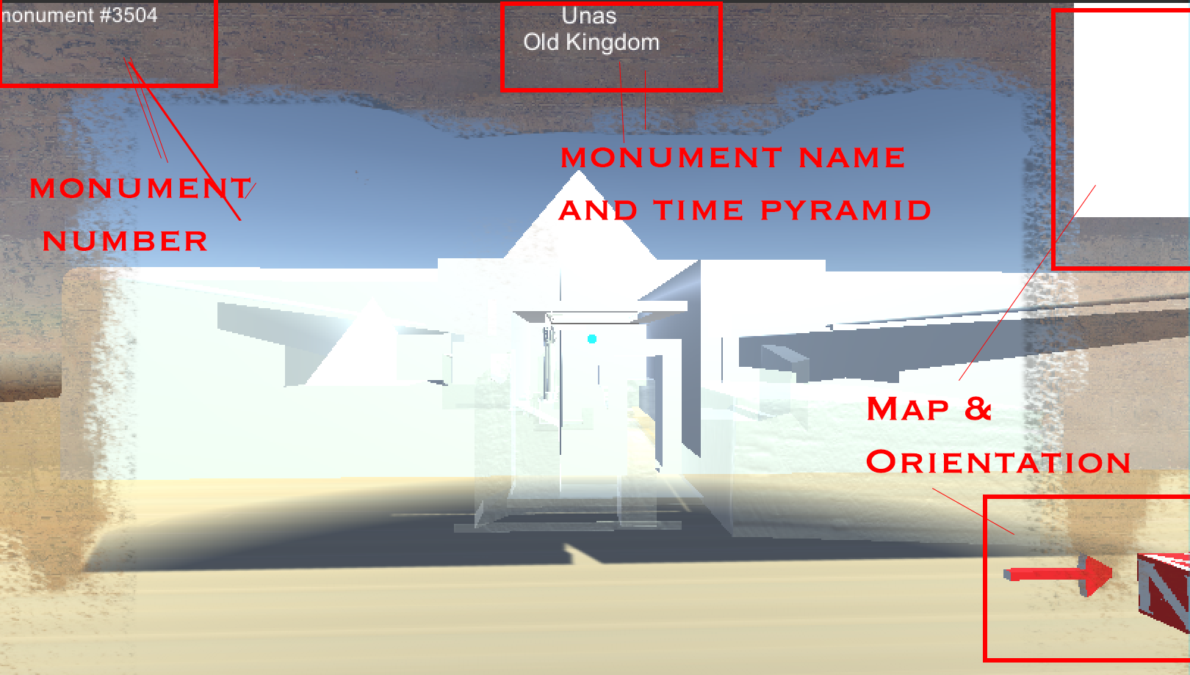
Gui data presented

Slide 6
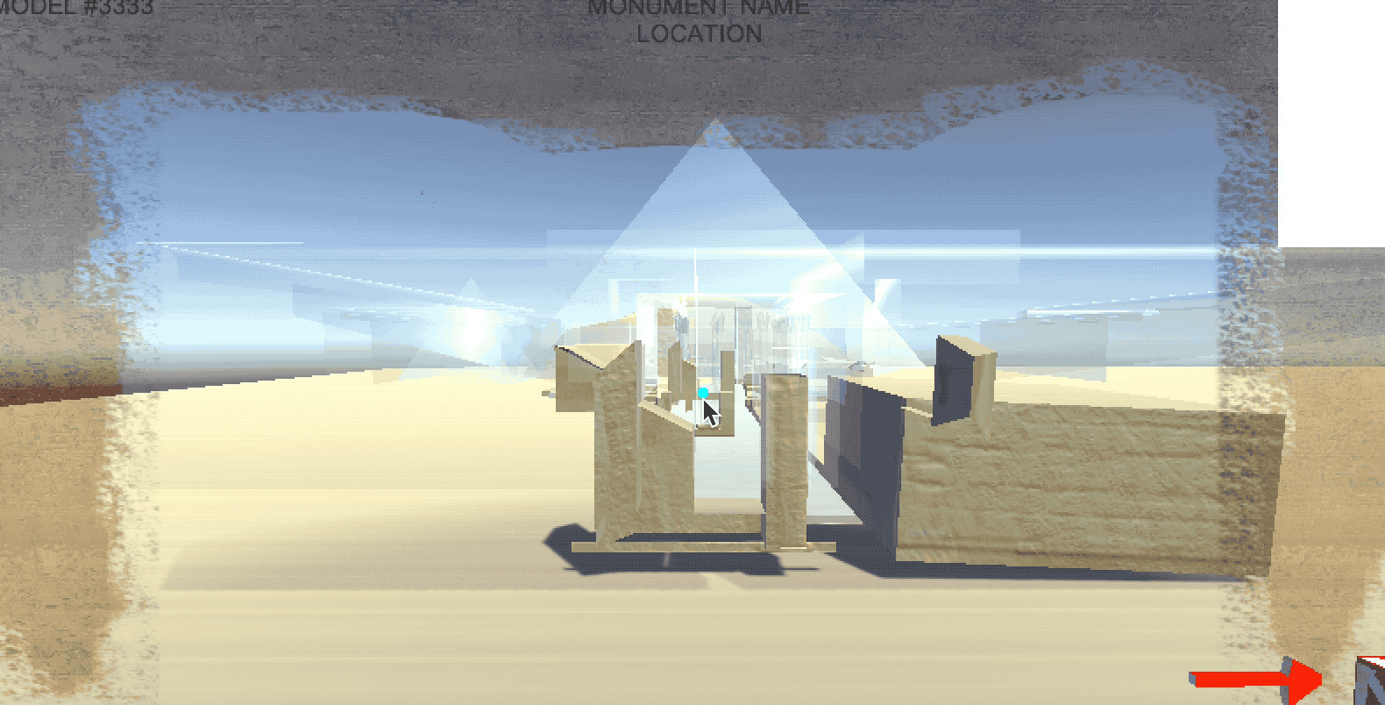
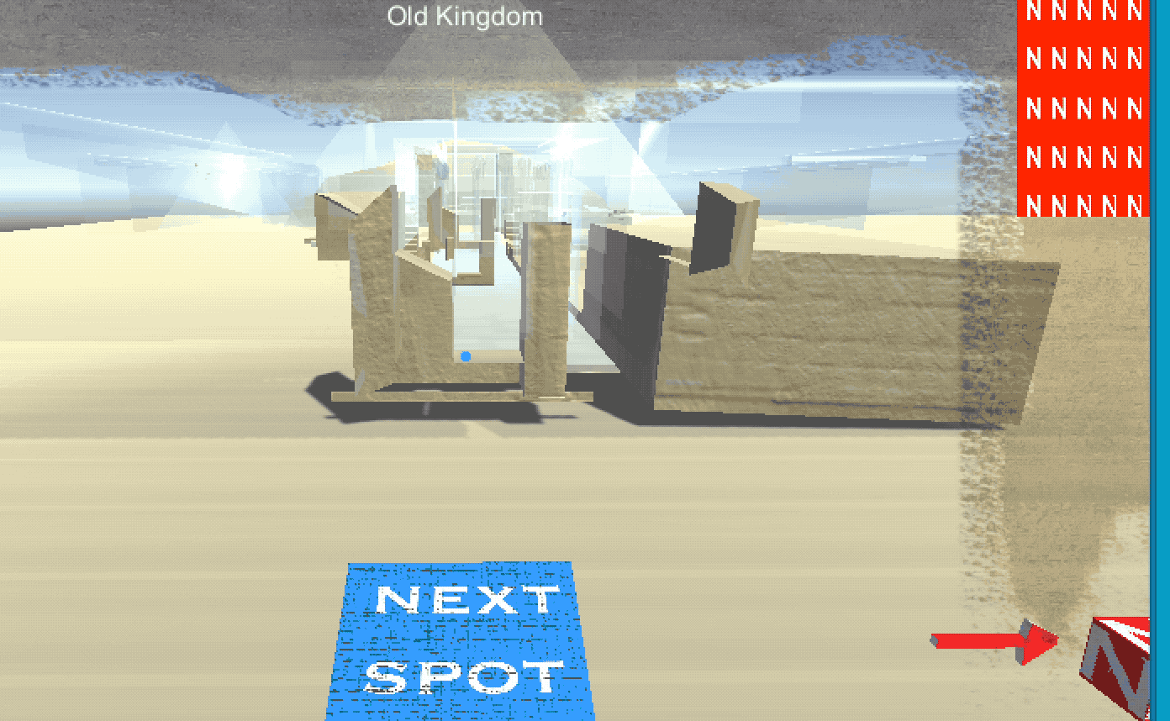
Moving and navigating the world
Moving between
states

Slide 7
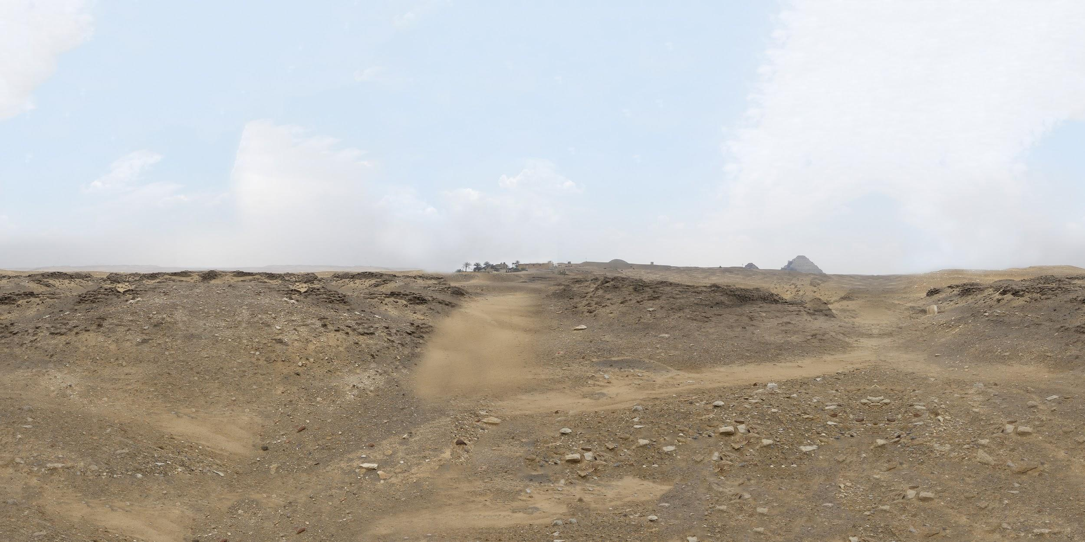
Visual Draft Skybox / 360° Environment
Equirectangular fabrication from basic photography provided by Dr. Sullivan

Slide 8
Sound and audio!
3D sounds to make another layer of immersion
Used Resonance Audio for Unity
Problems with sound
Ambisonic sounds are hard to find. So used some free sound from freesound.org
Ambisonic sound are very large. Use huge space in the device.
Not much resource - Or may be I have to dig deep

Slide 9
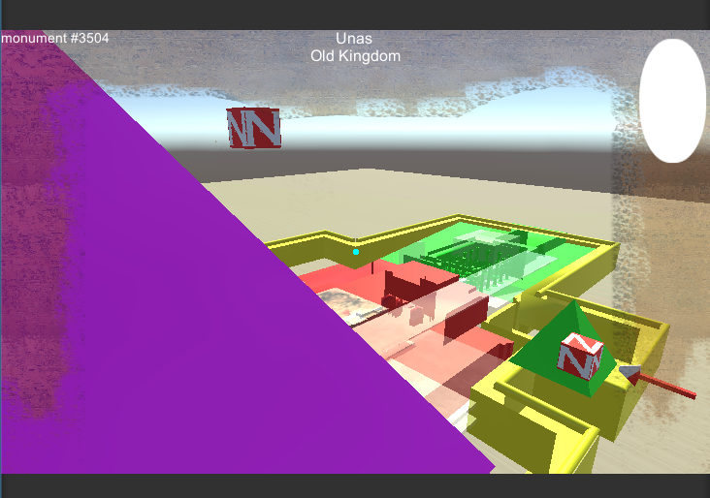
Next Steps:
Adding color to pieces of the model to present uncertainty %
Cleaning up rendering
Place final art in place of model placeholders
Elevation Map?

